Slide 1
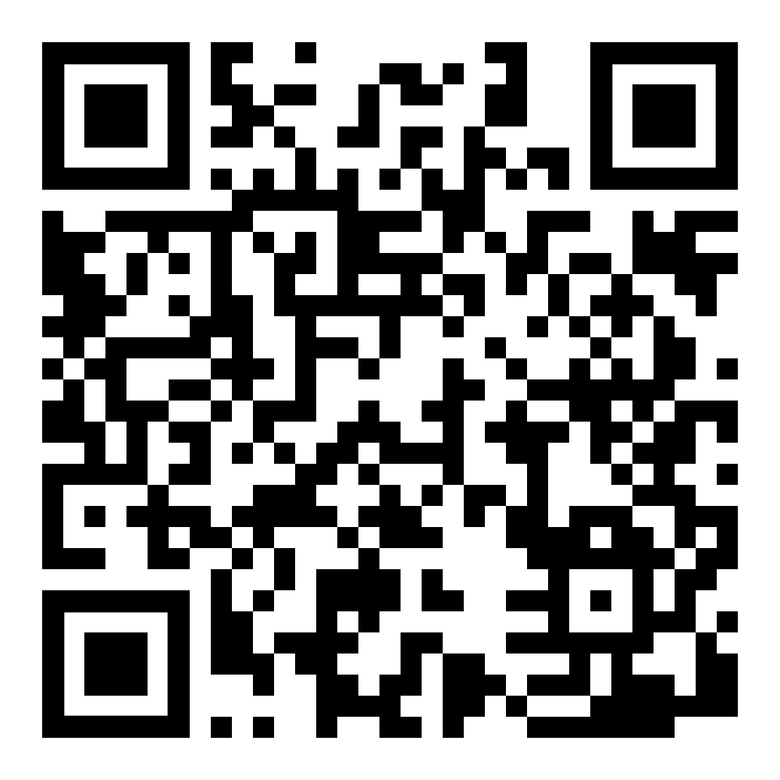
SI Leaders for Fall 2021
Applications DUE March 31, 2021

Slide 2
Responsibilities
Qualifications
Attend all course lectures
Plan & facilitate 3 sessions per week
Maintain a professional attitude
Complete required training
10-12 hours/wk (lecture, sessions, planning, meetings, observations)
Sophomore standing by Fall 2021
3.0 cumulative GPA
“B” or higher in the SI course, taken at a KSU campus
Desire to facilitate other students’ learning

Slide 3
Benefits
$9.20 starting pay
Prepare for future coursework & career opportunities
Develop valuable leadership skills
Supportive and fun community

Slide 4
Apply Today!
www.kent.edu/asc/studentemployment
If selected, Group Interviews will be scheduled in April
Priority applications due by March 31st, 2021

Slide 5
Questions?
Visit www.kent.edu/si
Email siprogram@kent.edu
Ask your SI Leader!

