Slide 1

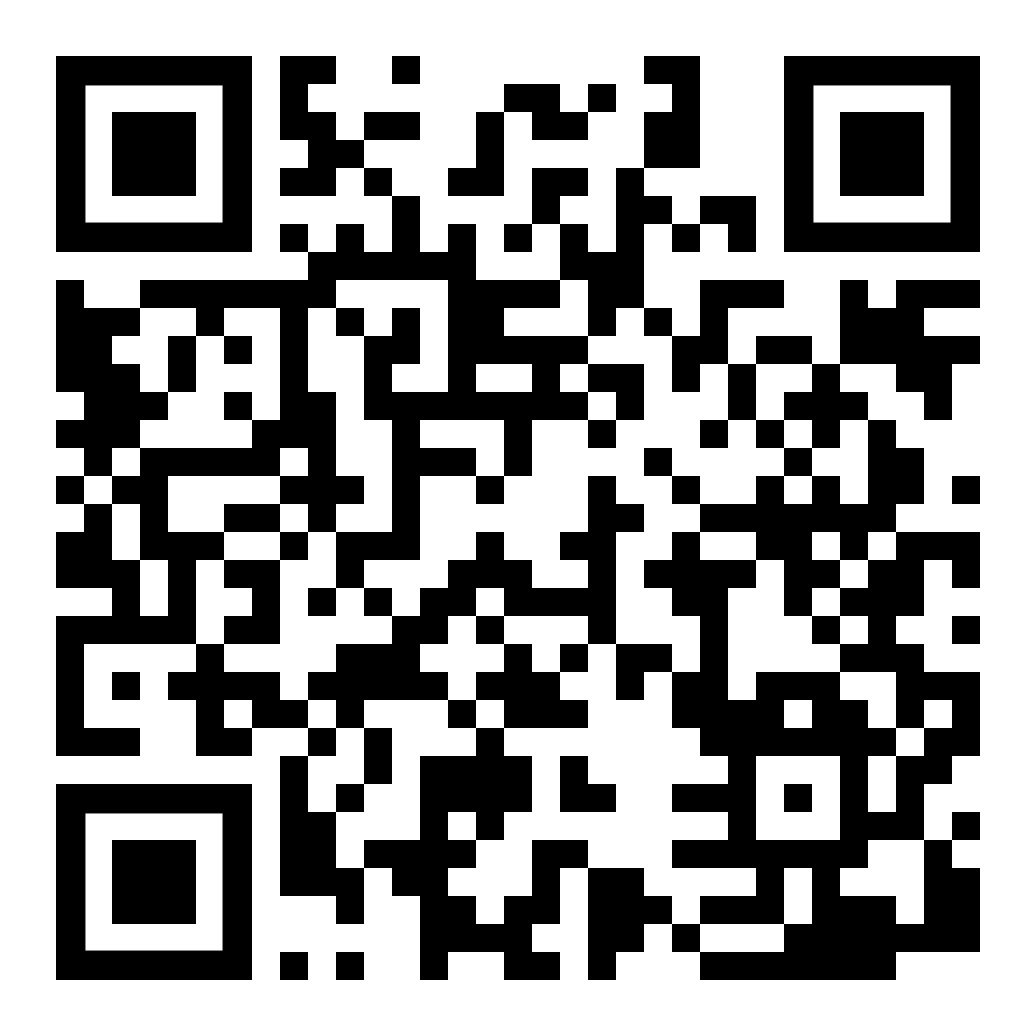
SI Leaders for Spring 2022
Priority applications due Friday, October 29th

